Slide 1
Facial Recognition Systems

Slide 2

Introduction Hook
“Imagine walking to buy groceries. A camera scans your face and a computer matches you to a mugshot. Two minutes later, police stop you. And they will not tell you why. Now stop imagining. It is happening here.”

Slide 3
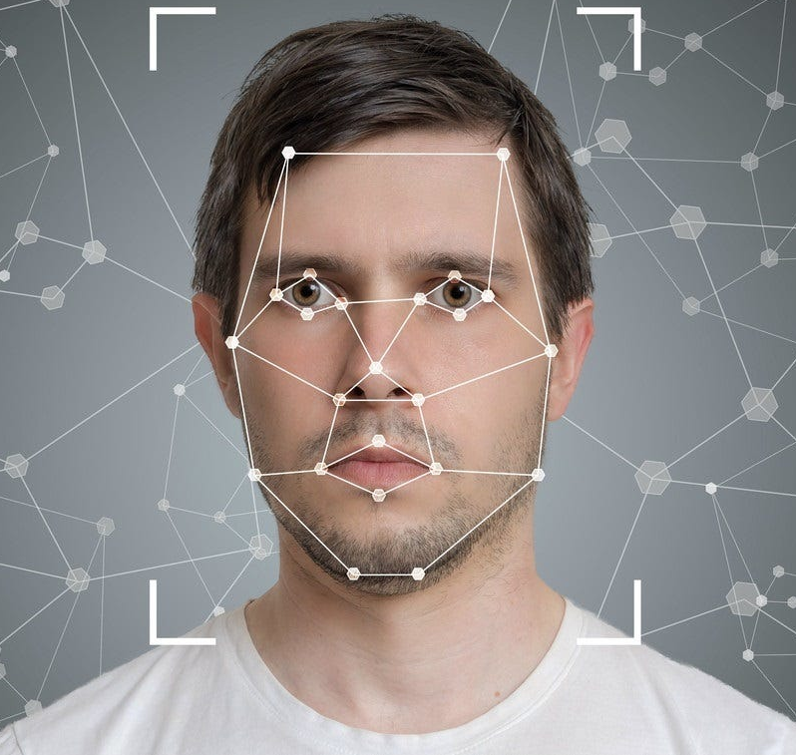
How It Works
Live facial recognition (LFR) uses AI (Gikay, 2023)
LFR analyzes faces captured by CCTV cameras (MacMillan & Schaffer, 2025)
Tech compares face features to mugshots or suspects

Slide 4
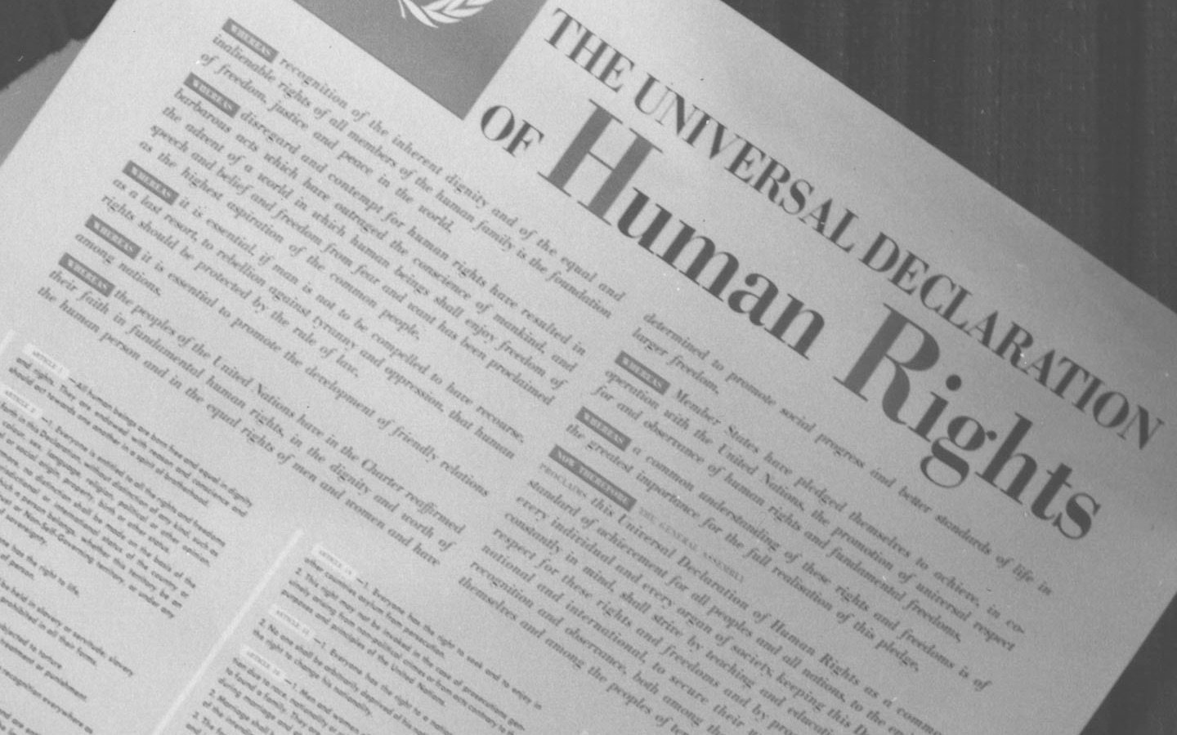
Human Rights at Risk
Right to privacy (UDHR Article 12)
Freedom of assembly (UDHR Article 20)
Freedom from discrimination (UDHR Article 7)

Slide 5

The Ethical Tension
Harvests biometric data without consent (Okonkwo, 2023)
Undermines the right to demonstrate
Targets people of color discriminately (Hickok & Hu,2024)

Slide 6

The Scene
Event occurred in New Orleans, Louisiana, U.S
Program was secretly active from 2023 (MacMillan & Schaffer, 2025)
Program exposed by the Washington Post in May 2025

Slide 7
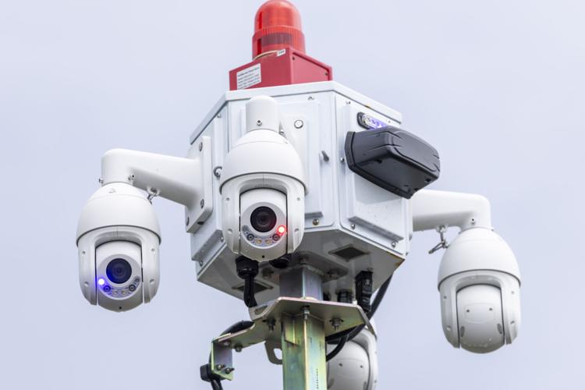
What Happened?
NOPD partnered with Project NOLA
200+ real-time LFR cameras were installed (MacMillan & Schaffer, 2025)
Software scanned passersby and sent instant alerts to officers (Gikay, 2023)

Slide 8

Who Was Affected?
34 residents were arrested (MacMillan & Schaffer, 2025)
Randal Reid was wrongfully arrested (Article 10 of UHDR) (Hickok & Hu,2024)
Blacks, immigrants, and activists (Article 8 of ECHR and Article 12 of UDHR)

Slide 9

Critical Analysis
Failure of democratic accountability
City Council banned real-time surveillance (MacMillan & Schaffer, 2025)
Police did it in secret (MacMillan & Schaffer, 2025)
Lack of transparency
Watchlist was private; Police did not log alerts
No way for the public or courts to check the bias of the system (Min, 2023)

Slide 10
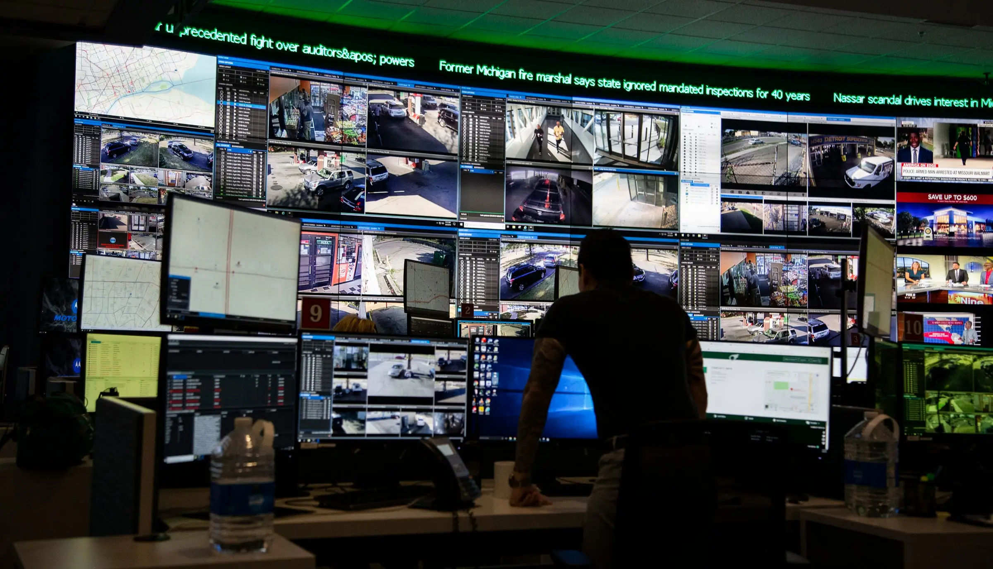
Impact & Aftermath
ACLU outcry for a full investigation and a new moratorium (MacMillan & Schaffer, 2025)
City forced to pause the program (MacMillan & Schaffer, 2025)
Case proves police can expand surveillance beyond what is legal or ethical

Slide 11

Recommendations
1. Prohibit real-time public surveillance
Pass laws that explicitly ban LFR in public
EU AI Act (Article 5) prohibits LFR for law enforcement ‌(Future of Life Institute, 2025)
Ban is the only way to prevent the mission creep seen in New Orleans

Slide 12
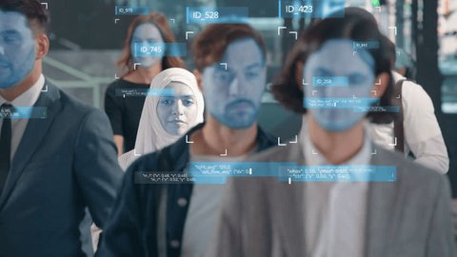
Recommendations (cont’d)
2. Make real-time audits mandatory
Use of FRS must be logged
Independent body to publish quarterly reports on the accuracy rate
EHRC is pursuing the same outcome in the Thompson v Met Police case (Equality and Human Rights, 2025)

Slide 13

Recommendations (cont’d)
3. Ban secret watchlists
Law that requires watchlists to be pre-approved by a judge
Regulation based on specific evidence of a crime
Citizens' right to know whether on a watchlist
Radanliev (2025) requires that AI systems be transparent through community participation

Slide 14
References
Equality and Human Rights. (2025). Met Police’s use of facial recognition tech must comply with human rights law, says regulator. Equality and Human Rights. https://www.equalityhumanrights.com/met-polices-use-facial-recognition-tech-must-comply-human-rights-law-says-regulator
Future of Life Institute. (2025, February 2). Article 5: Prohibited artificial intelligence practices. EU Artificial Intelligence Act. https://artificialintelligenceact.eu/article/5/
Gikay, A. A. (2023). Regulating use by law enforcement authorities of live facial recognition technology in public spaces: An incremental approach. The Cambridge Law Journal, 82(3), 414-449. https://doi.org/10.1017/S0008197323000454
Hickok, M., & Hu, E. (2024). Don’t let governments buy AI systems that ignore human rights. Issues in Science and Technology, 40(3), 37-41. https://doi.org/10.58875/ACOG7116.
MacMillan, D., & Schaffer, A. (2025, May 19). Police secretly monitored New Orleans with facial recognition cameras. The Washington Post. https://www.washingtonpost.com/business/2025/05/19/live-facial-recognition-police-new-orleans/
Min, A. (2023). Artificial intelligence and bias: Challenges, implications, and remedies. Journal of Social Research, 2(11), 1-33. https://doi.org/10.13140/RG.2.2.36029.03049
Okonkwo, O. A. (2023). Ethical tensions between AI surveillance architectures, human rights preservation, and the universal entitlement to digital privacy and dignity. Magna Scientia Advanced Research and Reviews, 9(2), 222-238. https://doi.org/10.30574/msarr.2023.9.2.0179
Radanliev, P. (2025). AI ethics: Integrating transparency, fairness, and privacy in AI development. Applied Artificial Intelligence, 39(1), 2463722. https://doi.org/10.1080/08839514.2025.2463722

